Slide 1
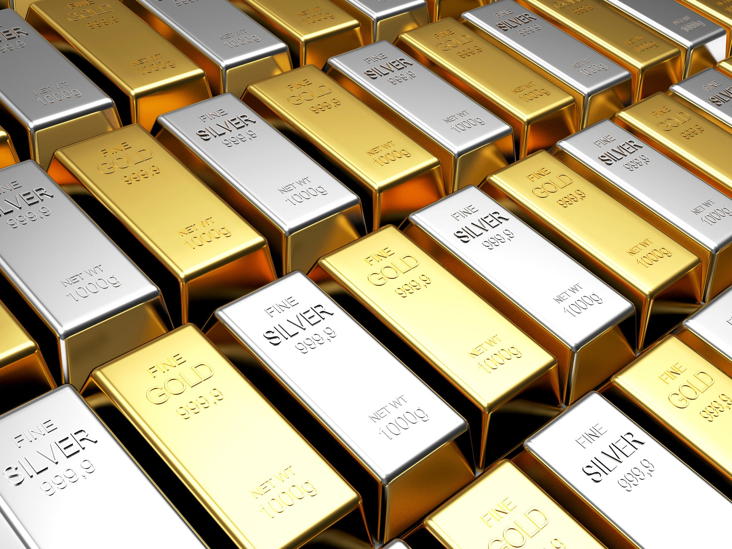
Analysis of Gold Trade from Ghana and South Africa
Presented By:
Joaquin Mancheno (97628277)
Vamsinath Reddy koduru (40734986)
Thilak Raju Sampath Kumar (40359170)
Ravi Kiran Naidu Talari(78215007)
Prajwal Tamang (92305354)
Viviane Da Silva Cristino (77846627)
Arpit Amborkar (47483065)
Srihari Gunti (61180160)

Slide 2
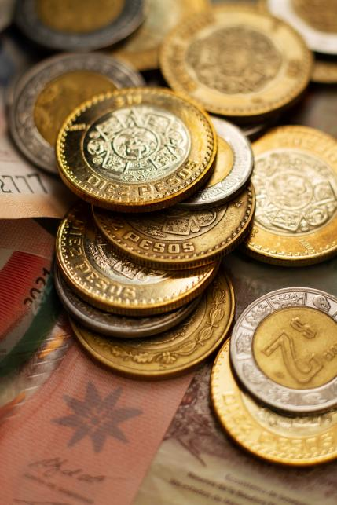
Introduction
Today gold is mainly used as a commodity that can help maintain economic value in times of global and economic instability or turmoil.
Countries like South Africa and Ghana historically been major producers and exporters of gold. Gold is a major contributor to the overall economy of both Ghana and South Africa and both countries are major contributors the global gold market.
The global gold market is influenced by various factors including wars, natural disasters, political instability, inflation, and demand.
Analyzing these factors helps in predicting gold market trends and anticipating its volatility.

Slide 3

Objectives
The objective of this study is to better understand the factors that can influence the global gold market by analyzing the gold trade in Ghana and South Africa.
By performing the following analysis like analysis of volume, price, and economic patterns given better understanding which economic, and global factors contribute the most to the fluctuations in the gold price.
With this analysis the objective of this study is able to predict and understand the gold market in south Africa and Ghana.

Slide 4

Methodology
In this analysis, various methods and techniques are performed. The data for the gold trades of Ghana and South Africa from 2017 to 2023 is downloaded from the source.
The data has been consolidated into one table with the important columns for the analysis and cleaned the data columns that contain repeated data. It is ensured that the data in the table was consistent such as correcting misspelled column headers, missing cells, or misalignments between the data and the headers in our table.
The EDA analysis is used to analyze and explain the research question in PowerBi tool.
In overall project Data collection, cleanup, descriptive analysis, EDA and finally data visualization is done in PowerBI and powerquery tools.

Slide 5
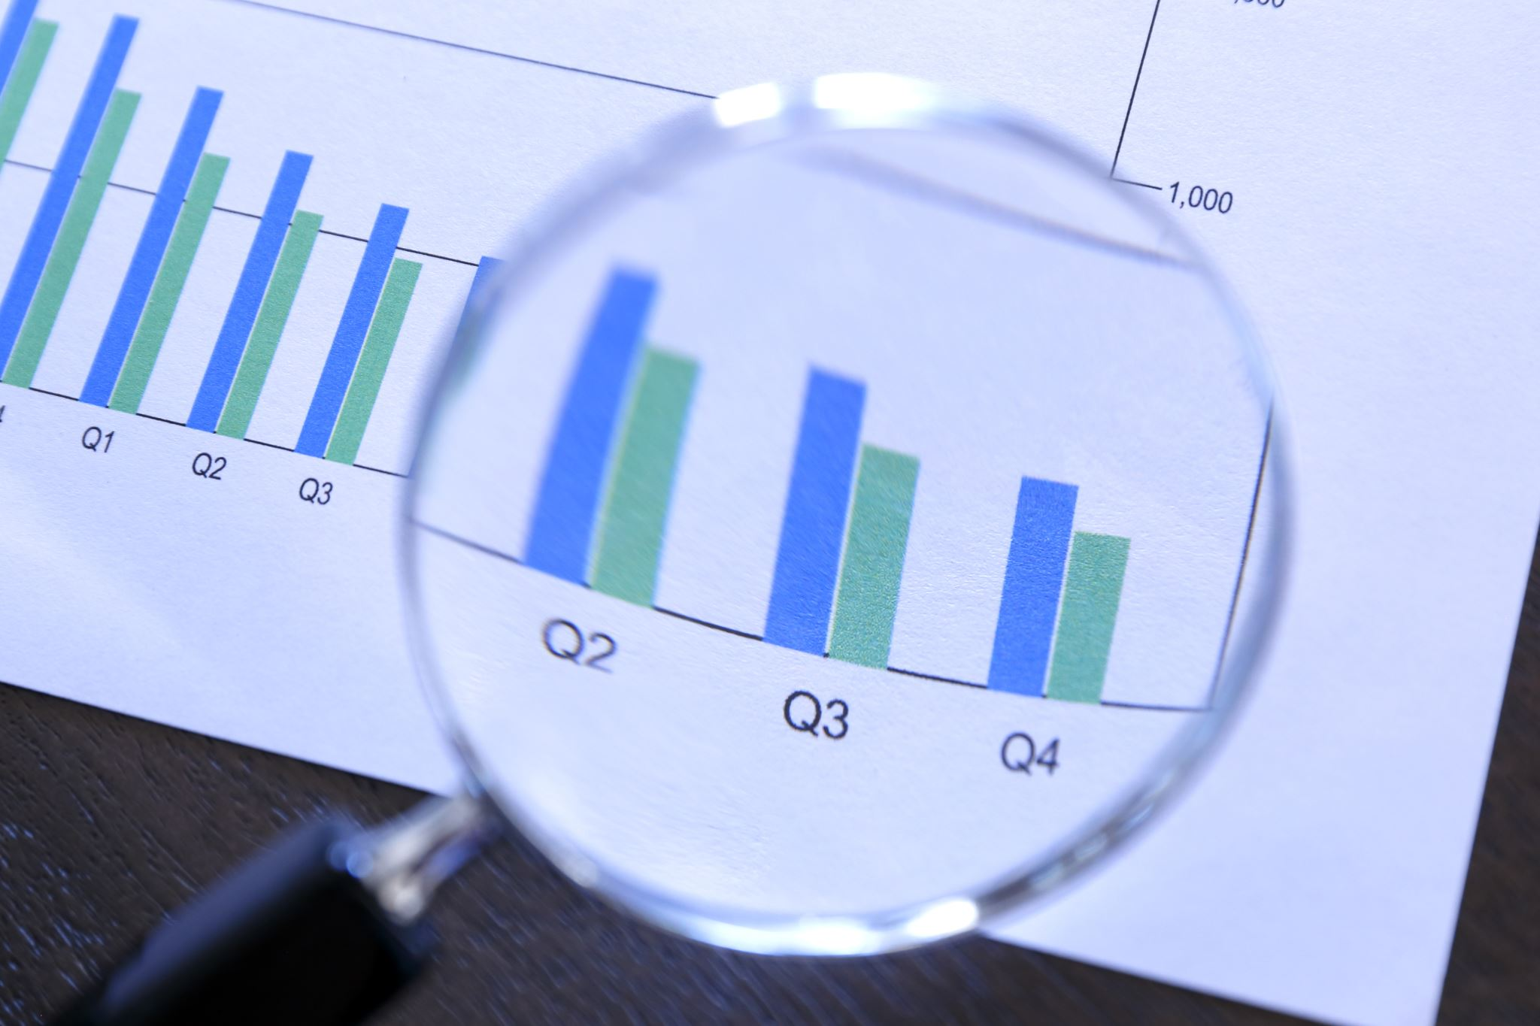
Research Questions
What is the trend in price data?​
What is the volume of trade?​
Are there certain days in the month where volume is higher/ lower than normal? ​
Are there certain months where prices are higher / lower than normal?​
Is there a correlation between “Volume” and “trade”? ​
Is there a trend in “Number of trades”? What does it specify?​
Volume traded (in comparison) to BRICS union (China, Russia, India) vs UK,USA
Based on the data given, predict the price of Gold in the next months.​

Slide 6
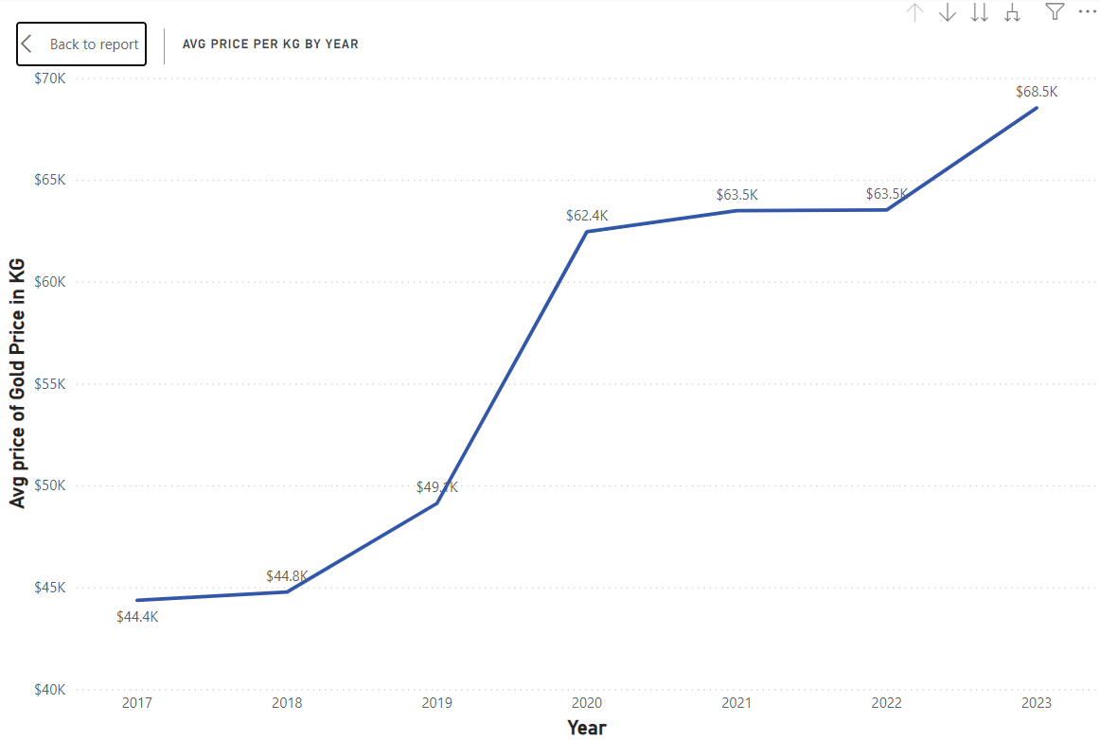
Price Trend By Year
Price tags increased by 54.27 percent of the 2017 to 2023.
Price value remained round $ 44.4K in 2018.
Price saw a significant increase in 2019 to around $ 49.1K. After that, the price remained constant at $ 63.5K by the year 2022.
This could be attributed to after COVID recovery of economies and lesser demand for gold. This happened for two years.
In 2022-2023, the price of gold went up to $ 68.5K.
Meanwhile, this year marked the start of conflict between Russia and Ukraine.

Slide 7
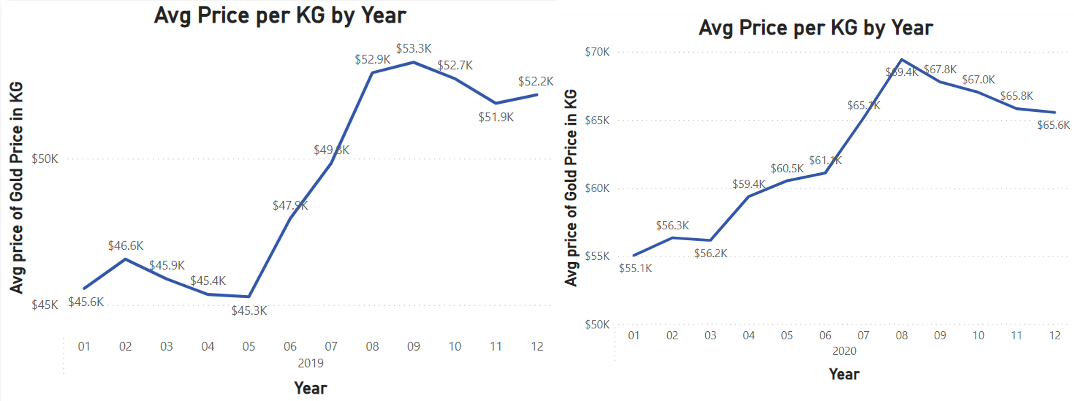
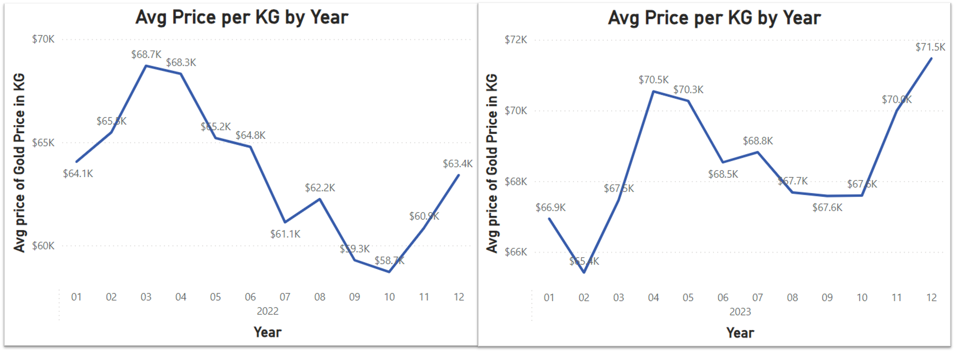
Price Trend By Year
Average Price per kg for each month of the 2019 and 2020.
Average Price per kg for each month of the 2022 and 2023.

Slide 8
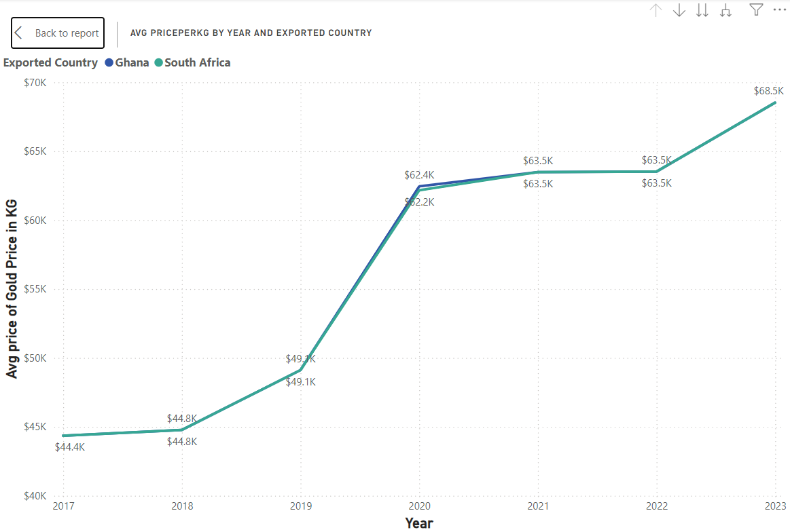
Annual Price Trends by Exporting Country
The trend for the price by exported country is the same for both countries of Ghana and South Africa throughout 2017 to 2023.
Except for the year 2020, in this year Ghana had a slightly
Higher price of about $ 62.4K than South Africa whose price was $ 62.1K

Slide 9
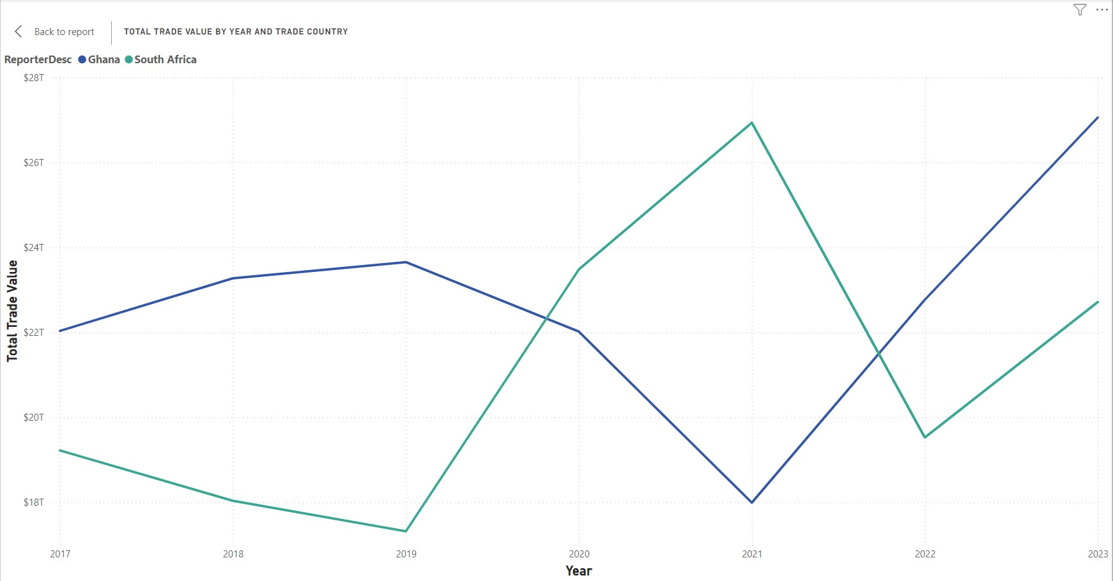
Trend in Trade By Year And Country
From 2017 to 2019, South Africa's total trade value decreased from approximately $20T to around $16T, while Ghana's increased from around $22T to $24T, showing divergent trade trends.
In 2020, Ghana’s trade value dropped below $22T, whereas South Africa’s rose sharply, surpassing $20T, marking a pivotal year where their trade values intersected.
After 2020, Ghana’s trade value rebounded sharply to over $26T by 2022, while South Africa’s value, after peaking in 2020, dropped significantly in 2021 before partially recovering in 2022.
Ghana exhibits a consistent upward trend in trade value from 2017 to 2023, with only a slight dip in 2020, indicating strong and resilient trade performance.
South Africa's trade value shows more volatility, with a sharp increase in 2020 followed by a significant drop in 2021 and partial recovery in 2022, suggesting fluctuating trade activities.

Slide 10
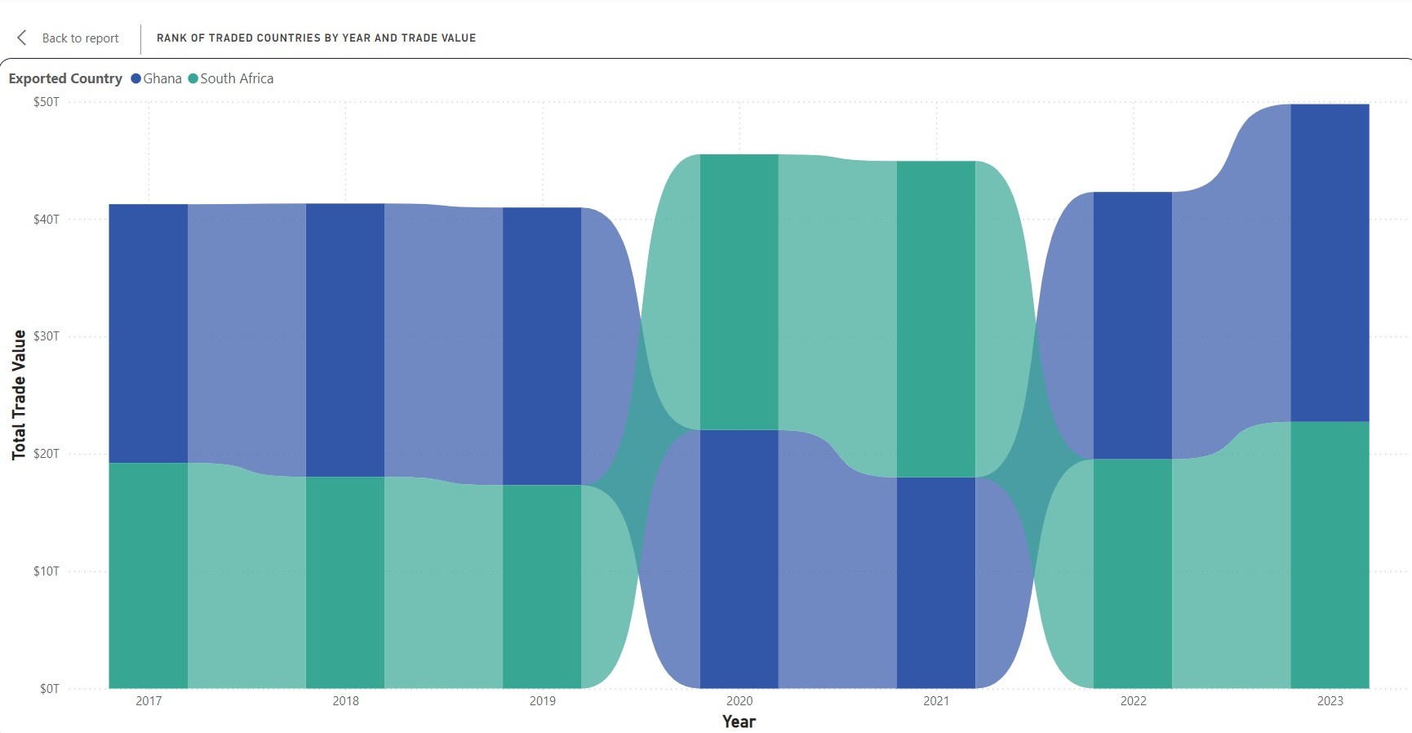
Annual Ranking of Countries by Trade Value
Ghana's trade value remained high and consistent from 2017 to 2019, dipped in 2020, and then rebounded from 2021 to 2023.
South Africa's trade value significantly increased in 2021 and stayed higher compared to previous years.
Both countries saw changes in trade values in 2020, likely due to the COVID-19 pandemic, with Ghana experiencing a drop and South Africa a slight increase.
Ghana led in trade value from 2017 to 2019, but South Africa surpassed Ghana from 2021 onwards.
By 2023, both countries reached high trade values, with Ghana slightly ahead of South Africa again.

Slide 11
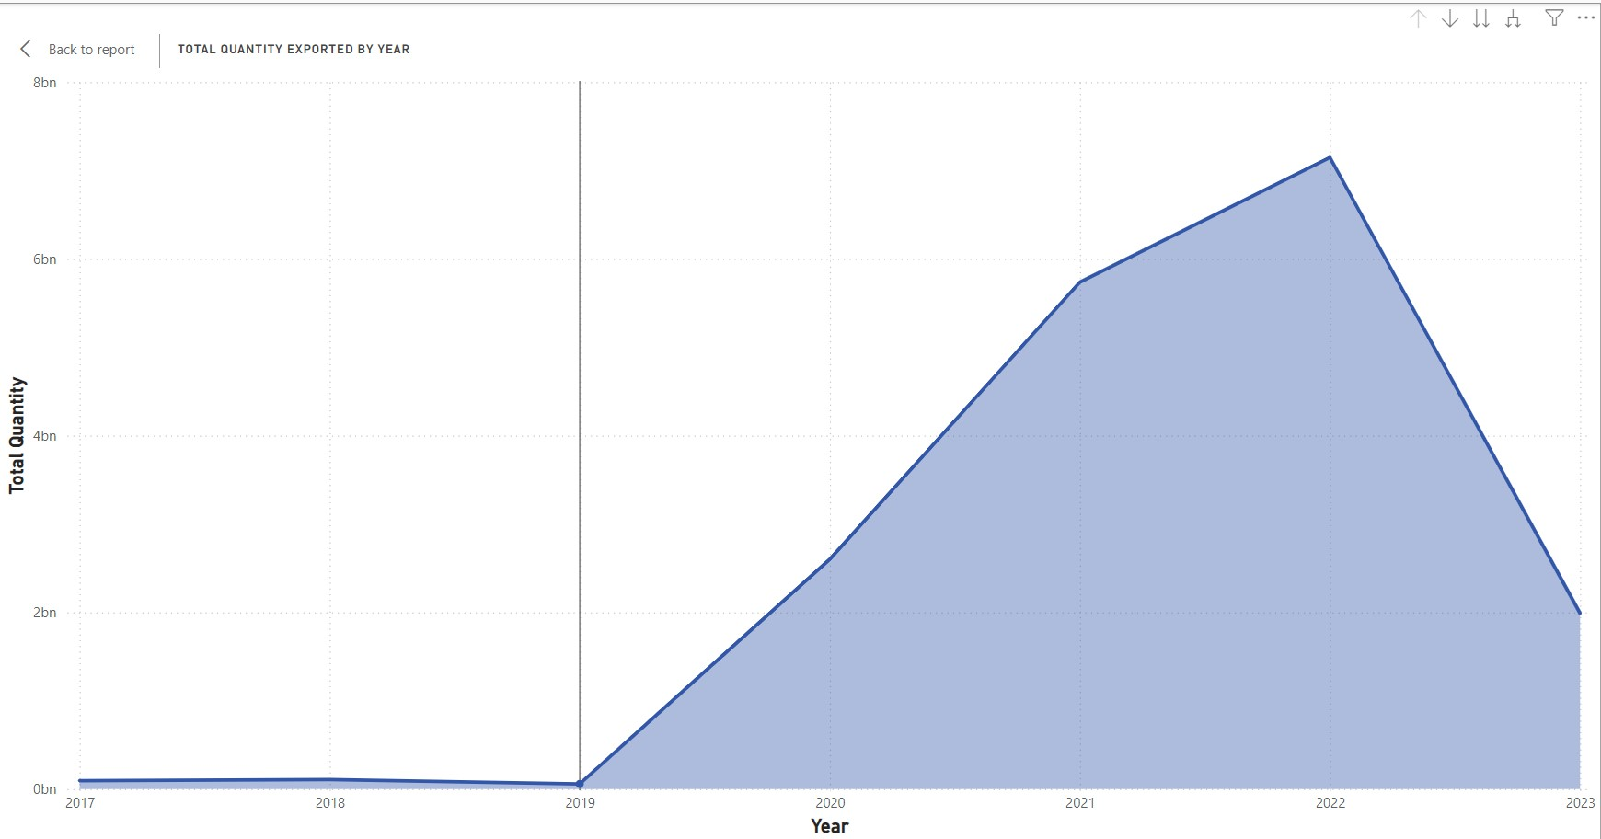
Yearly Export Quantity
There was a significant and steady increase in the total quantity of gold exported each year From 2019 to 2022. The quantity rose from virtually negligible levels in 2019 to its peak in 2022.
The highest quantity of gold exports occurred in 2022, reaching nearly 8 billion units. This marked the culmination of a three-year growth trend.
There was a sharp decline in the total quantity of gold exported in 2023. The quantity dropped from the peak in 2022 to levels similar to those before the growth trend began.
Prior to 2019, the quantity of gold exported was consistently low, showing minimal change or growth. This indicates that the significant increase in exports started around 2020.
The sudden rise beginning in 2020 and the steep decline in 2023 suggests external factors or significant changes in market conditions, policies, or global events impacting the gold export industry.

Slide 12
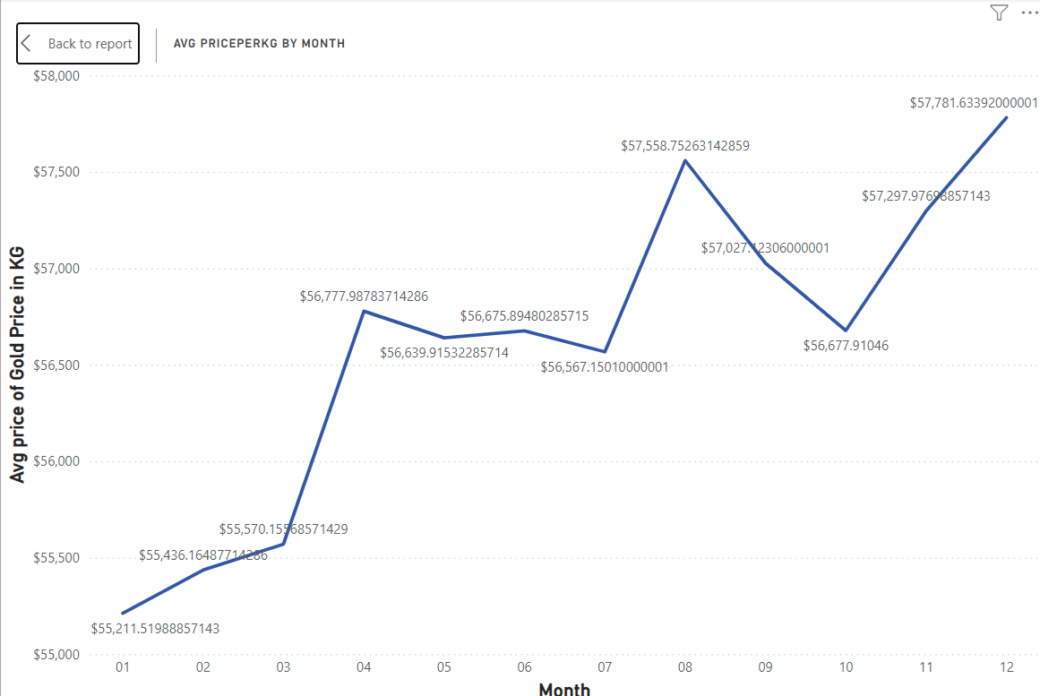
Price Trend By Month
The average price of gold per kilogram shows a steady increase from January to April, indicating a rising trend in gold prices during the early part of the year.
From April to August, the gold price stabilizes around $57,000 per kilogram, suggesting a period of price consolidation.
There is a notable dip in gold prices from August to October, with the lowest point occurring around October, indicating a decrease in gold demand or external market influences during this period.
After hitting the low in October, the gold price recovers significantly from November to December, showing an upward trend and closing the year on a higher note.
The graph illustrates overall volatility in the gold market, with notable fluctuations in prices, especially in the latter half of the year, which could be influenced by various economic factors and market sentiments.

Slide 13
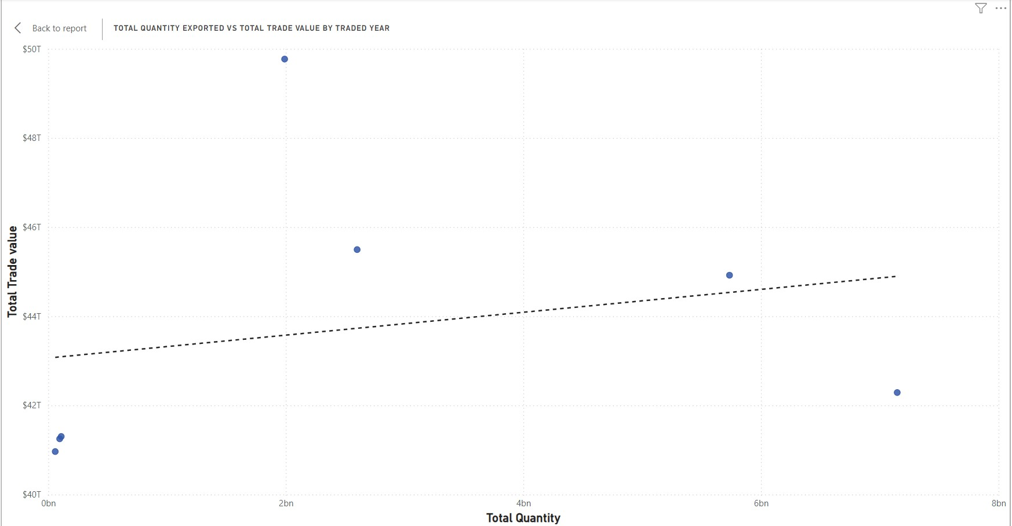
Yearly Export Quantity vs. Trade Value Comparison
The graph displays a clear positive correlation between Total Quantity Exported and Total Trade Value. This implies that as the quantity of exports increases, the overall trade value also tends to rise.
The data points seem to follow a linear trend, suggesting a consistent proportional relationship between the two variables. This linearity can be further confirmed by the presence of the fitted trend line.
The upward trajectory of both the Total Quantity Exported and Total Trade Value indicates growth over the years represented on the graph. This growth is particularly evident in the years closer to the present (right side of the graph).
While the overall trend is positive, there appear to be year-over-year fluctuations in both quantity and value. Some years exhibit higher exports and trade values compared to others, which could be due to various factors like market demand, economic conditions, or global events.

Slide 14
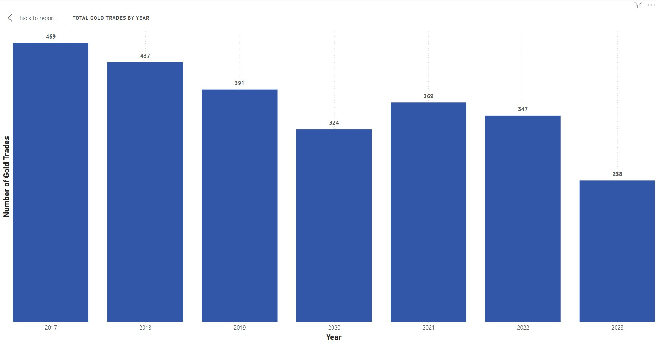
Trend in Gold Trade
The graph displays a general decline in the total number of gold trades from 2017 to 2023.
The most notable decrease occurred in 2023, with a substantial drop in the number of gold trades compared to previous years.
While there is an overall downward trend, there are fluctuations in the number of gold trades from year to year.
The year 2017 recorded the highest number of gold trades during the period represented on the graph.
The reasons behind the fluctuation might be Economic conditions (recessions, growth), geopolitical tensions (wars, trade disputes), investor sentiment (risk aversion, market trends), and changes in gold supply or demand.

Slide 15
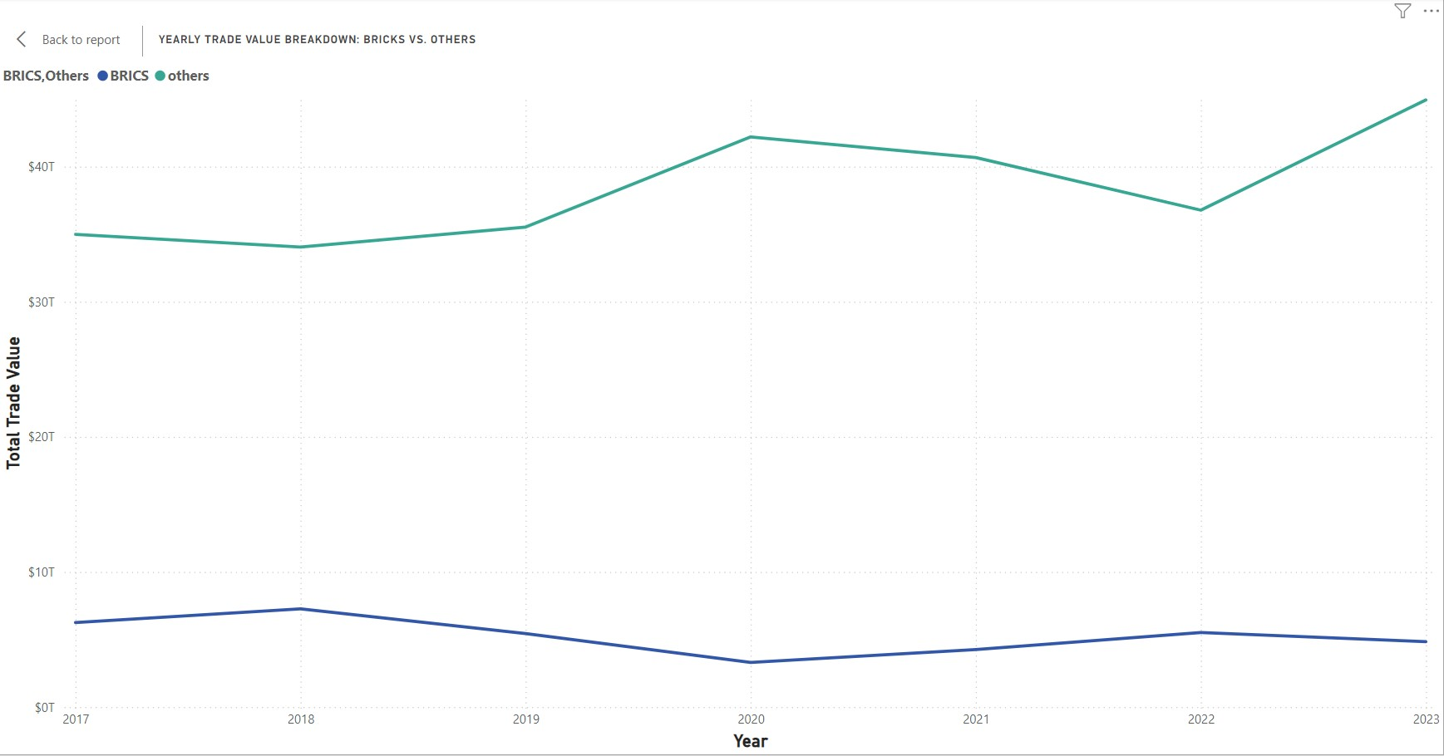
Gold trade Comparison BRICS vs NON-BRICS
The total trade value for "others" consistently increases from around $35T in 2017 to over $40T in 2023, showing steady growth.
The trade value for BRICS countries remains relatively stable, fluctuating around $7T to $8T from 2017 to 2023.
Both BRICS and "others" experience a dip in trade value in 2020, likely due to the COVID-19 pandemic, but recover in subsequent years.
The gap between the trade values of "others" and BRICS widens over the years, with "others" increasing their lead.
"Others" exhibit more noticeable peaks and troughs, particularly peaking in 2021, dipping in 2022, and rising again in 2023, indicating year-over-year variability.

Slide 16
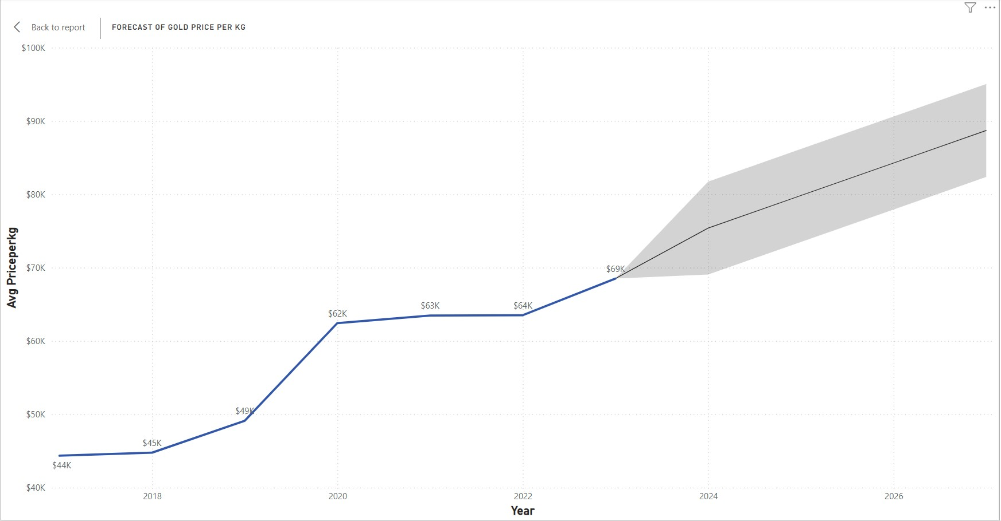
Forecast Of Gold Price
The graph displays the average sum of the price of gold per kg from 2017 to 2023 and the analysis in the report is for the future projected trends in the price of gold from 2023 to 2026.
From 2017 to 2018 the price per kg of gold increased to about 45 thousand dollars.
During the year 2020 to 2021 a slight increase in the price In 2023 price per kg of gold increased to $68k with a moderate positive trend this was due to conflicts or trade disputes.
The cost is anticipated to rise from $69K per kg in 2023 to around $90K per kg by 2028.
In any case, the wide forecast interim for the afterward long time demonstrates critical instability, requiring checking of financial markets and geopolitical improvements.
Notes:
This graph shows the sum of gold per kg from 2017 to 2023 and we have done an analysis in the report for the future projected trends in the price of gold from 2023 to 2028.
-The X-axis represents the year and Y-axis represents avg price per KG of gold. The above graph captures the historical price trends of gold over the years and includes a forecast section which is denoted by the shaded area. The shaded area shows the potential price of gold including the risk factors.
First we'll look into the historical data (2017-2023):
2017: Stable starting point at $44K per kg.
2018: Minor increase to $45K per kg, possibly due to inflation or demand.
2019: Noticeable rise to $49K per kg, linked to geopolitical tensions and economic uncertainties.
2020: Significant jump to $62K per kg, correlating with COVID-19 pandemic disruptions.
2021: Slight increase to $63K per kg, sustained by ongoing economic uncertainty.
2022: Minor increase to $64K per kg, reflecting steady post-pandemic demand.
2023: Moderate rise to $68K per kg, driven by global inflation and geopolitical tensions.

Slide 17
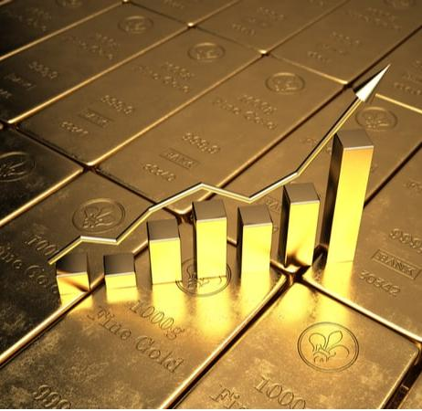
Result
Analysis of the Gold trade of Ghana and South Africa as well as the comparison of gold trade between BRICS nations and non-BRICS focuses on price, trade volume, and export quantities.
From 2017 to 2023, Ghana and South Africa combined exported 18 billion kilos of gold, generating a total amount of 306 trillion USD.
Ghana's best year in terms of gold trade was 2023, with 27 trillion USD generated, while South Africa's best year was 2021, with a total trade value of 26 trillion USD.
The price of gold steadily increased from 44 thousand USD per kilo in 2017 to 68 thousand USD in 2023, indicating rising demand likely due to global economic uncertainty.
The number of trades per year declined from 469 trades in 2017 to 238 trades in 2023, possibly due to increased efficiency and stricter regulations.
BRICS countries consistently traded more gold than non-BRICS countries, highlighting the significant influence of BRICS nations on the global gold market.

Slide 18
Conclusion
The price of gold is predicted to continue rising in the upcoming months, potentially extending for a few years.
The negative economic effects of the COVID-19 pandemic, the war in Ukraine, and other global conflicts are expected to influence the gold market.
BRICS nations consistently trade more gold than non-BRICS countries, demonstrating their significant influence on the global gold market.
As economic stability returns, there is a possibility of a decrease in gold prices, although this is not likely to happen in the short term.
Understanding market dynamics and global economic factors is crucial for predicting future trends in the gold market.

